Slide 1
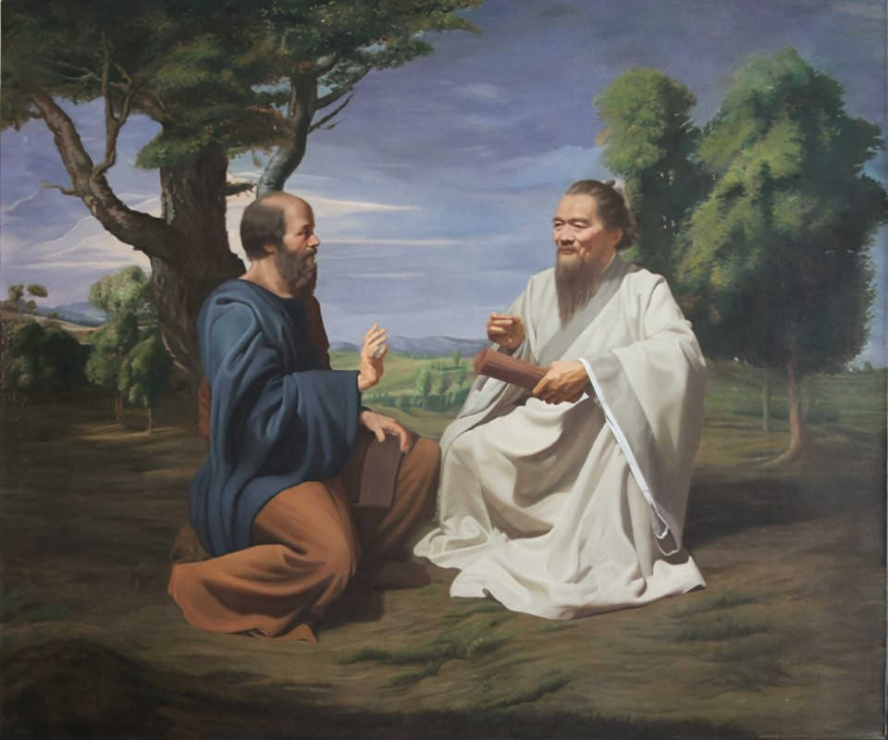
Socrates
and Confucius
Similarities and Differences
By Group 2

Slide 2
1
Lifestyle
THE
CONTENTS
Similarities
2
Family origin
3
Teaching style
Difference

Slide 3
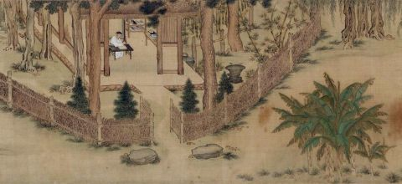
PART
01
Lifestyle

Slide 4
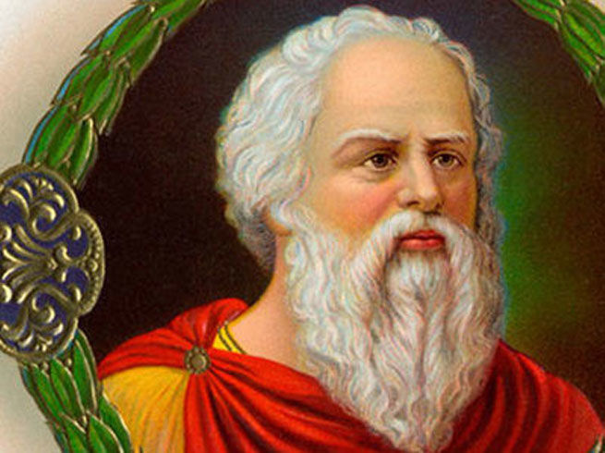

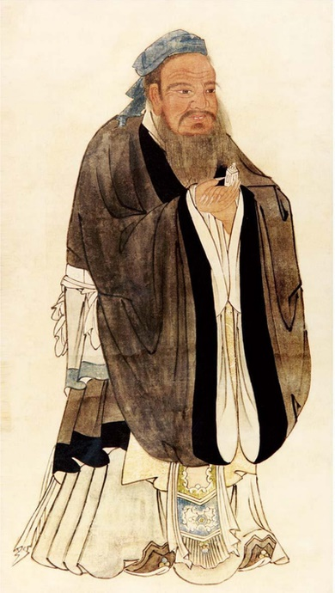

They are Most Happy and Nearest the Gods that Needed Nothing.
Socrates：
Coarse rice to eat, water to drink, my bended arm for a pillow - therein is happiness. Wealth and rank attained through immoral means are nothing but drifting clouds.
（饭疏食，饮水，曲肱而枕之，乐在其中矣。不义而富且贵，于我如浮云）
Confucius:

Slide 5
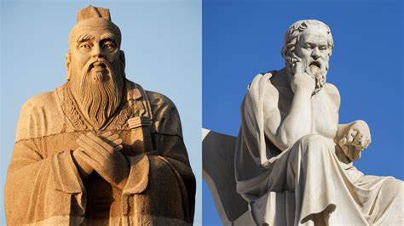
PART
02
Family Origin

Slide 6
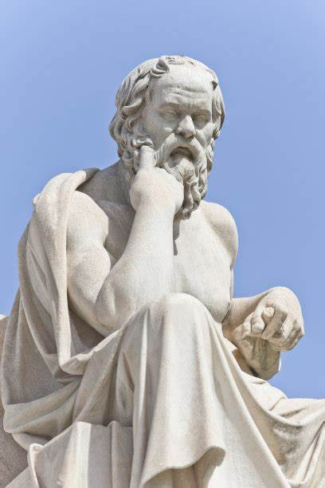
Confucius
Socrates
I was born without rank
and in humble
circumstances, so I did
tasks that bordered on the menial.
Born in an ordinary family.

Slide 7
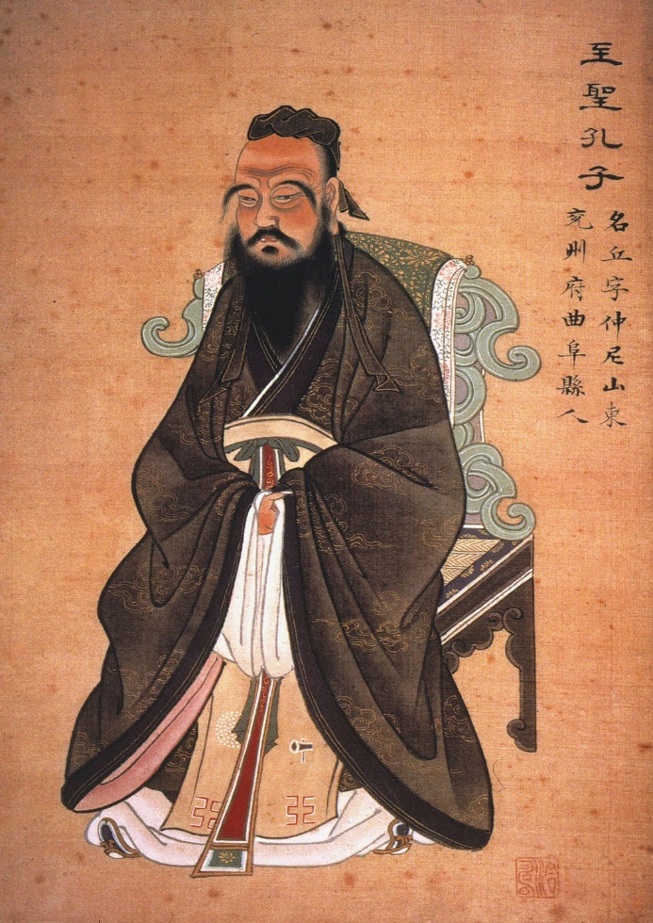
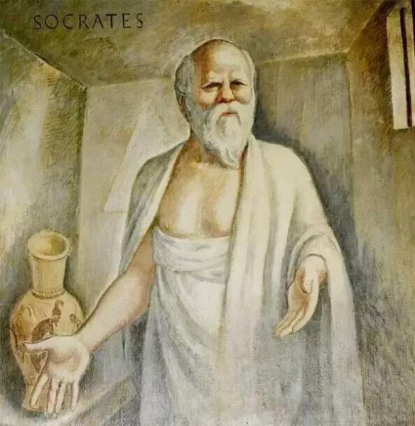
PART
03
Teaching style

Slide 8
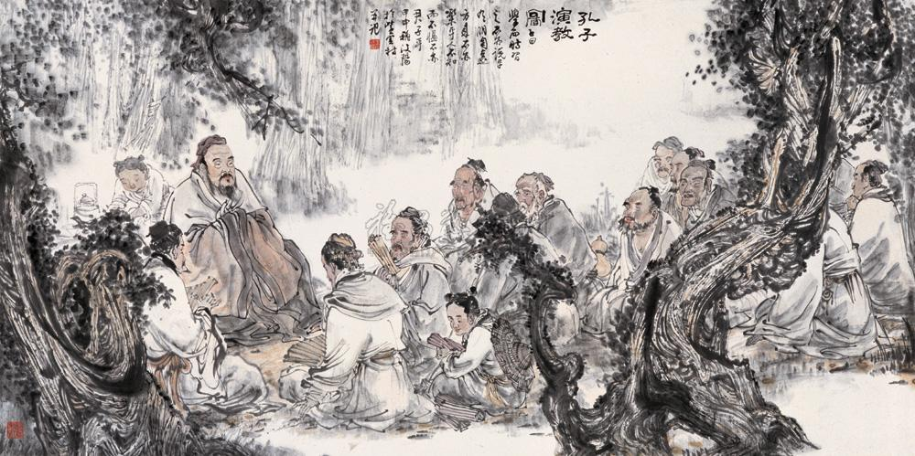

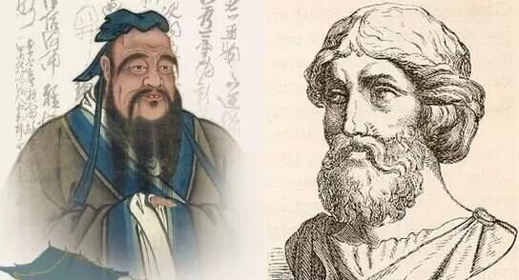

Form : Dialogue
Differences?

Slide 9
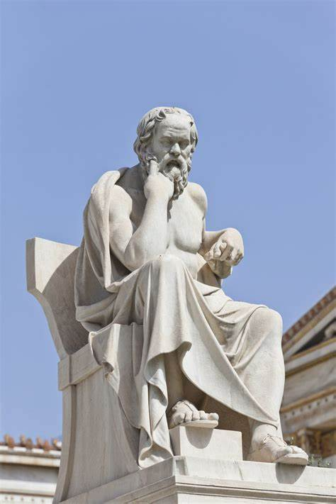
Socrates
Enlightening people
Confucius
Admonishing people

Slide 10
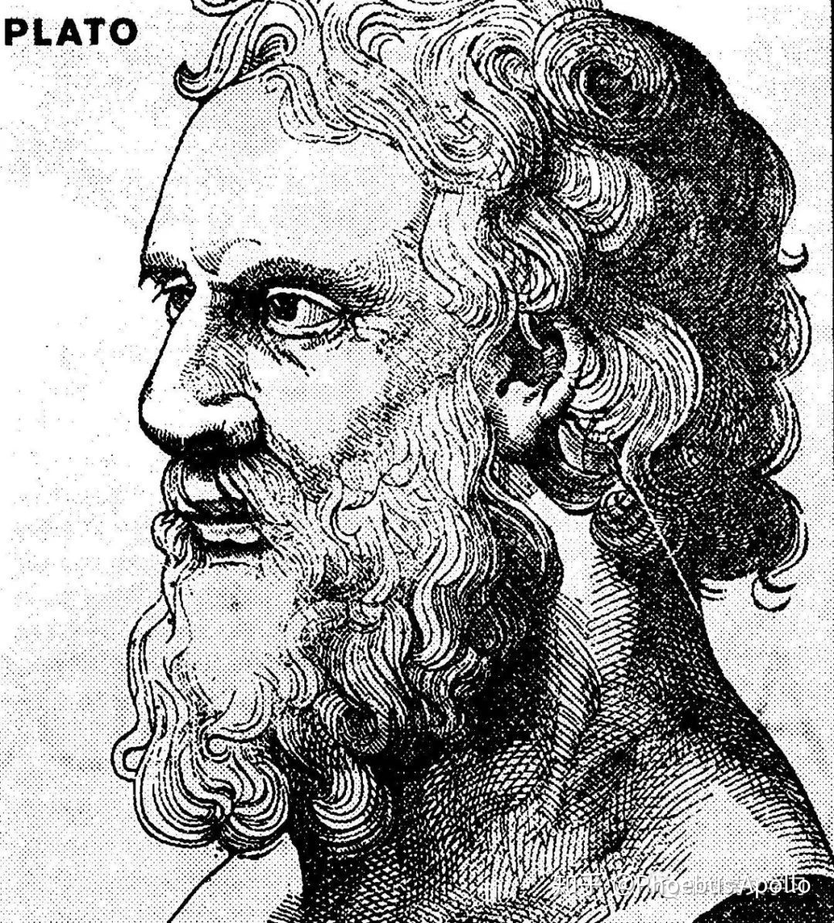
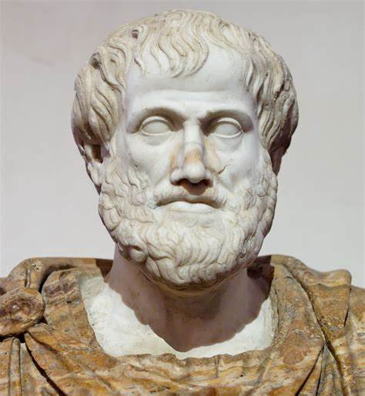
Plato
Aristotal

Slide 11
Learning
Memorization
Exploration
Imitation
Criticism
Disharmony
Imagination
Nonsence
Creation
Mischief

Slide 12
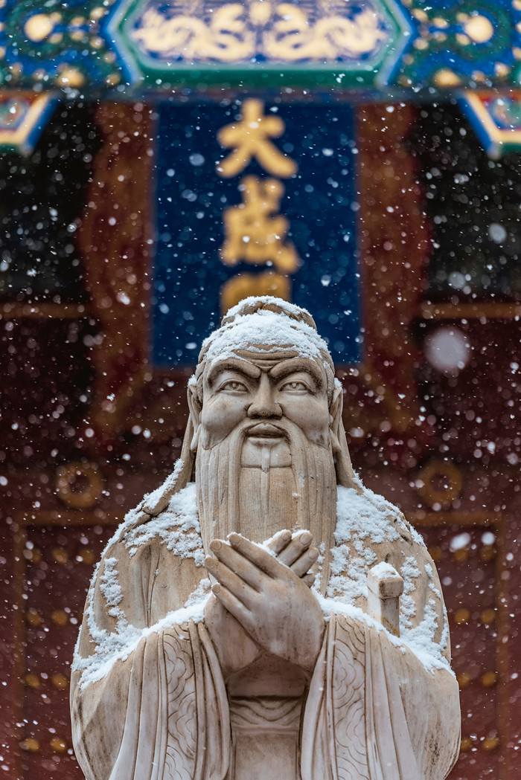
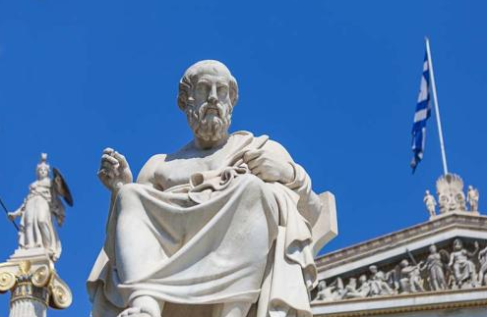

Slide 13

THANK YOU
FOR
LISTENING

